Slide 1
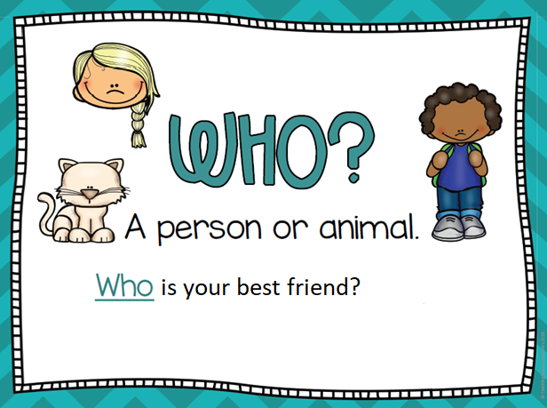
WHO is next to you?
WHO has got long hair
in your house?
WHO is your music
teacher?

Slide 2
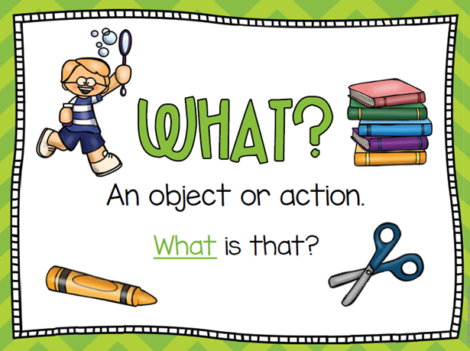
WHAT COLOUR is
your dog?
WHAT is your mum
doing?
WHAT´s on your table?

Slide 3
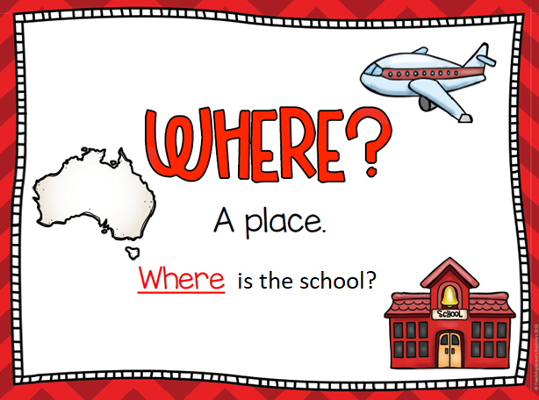
WHERE is your bag?
WHERE is your dad?
WHERE are you now ?

Slide 4
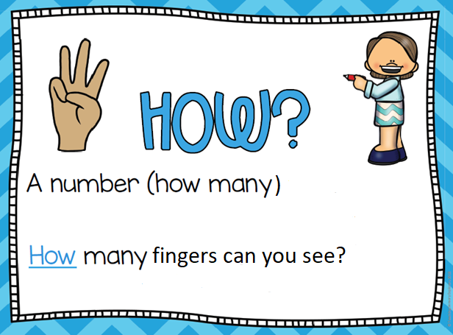
HOW MANY brothers
have you got?
HOW MANY people
are there in your
family?
HOW MANY bedroom
Are there in your house?

Slide 5
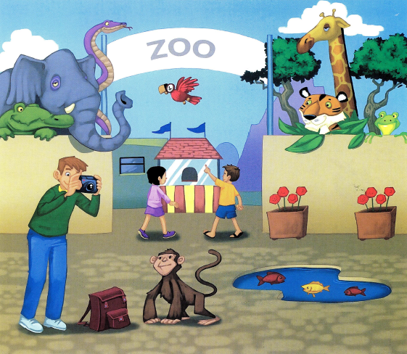

Slide 6
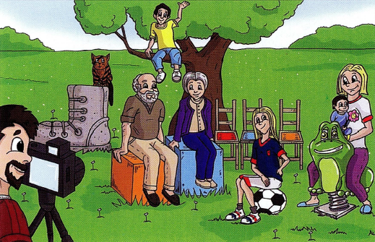
THERE IS
(singular)
* There is one girl.
* There is a cat.
* There is a big grey
boot.

Slide 7

THERE ARE
(plural)
* There are three chairs.
* There are seven
people.
* There are three birds.

Slide 8
